Slide 1
Use PowerShell + Graph
to build your own solutions for managing Intune resources
Damien Van Robaeys - @syst_and_deploy

Slide 3

A bit about me
Job
Microsoft MVP
System engineer at Metsys
MVP x5
From
Twitter
Picture
Paris, FRANCE
@syst_and_deploy
My Blog
Contact
http://www.systanddeploy.com
damien.vanrobaeys@gmail.com

Slide 4
Follow me
Website
https://www.systanddeploy.com
Twitter
@syst_and_deploy
Join me
Linkedin
https://www.linkedin.com/in/damien-van-robaeys-mvp-2a648627/
Facebook
https://www.facebook.com/systanddeploy

Slide 5


Examples and PowerPoint
All examples and PowerPoint are available on GitHub
GitHub link: https://github.com/damienvanrobaeys/Workplace_Ninja_Summit_2021

Slide 6
Blog posts about Graph and Posh
6

Slide 7
Some of my posts
See below some of my blog posts:
Play with MS Graph Explorer to interact with Intune
Manage Intune with MS Graph and PowerShell
Create an Azure application to authenticate to Intune Graph module with PowerShell without need to use your own credentials
Manage Intune Proactive Remediation scripts with PowerShell and Graph
MS Graph and Intune - A quick way to find the Graph equivalent from the Intune portal
Authenticate to the Intune PowerShell module using an Azure application and a certificate

Slide 8
Summary
What is MS Graph ?
What to do with MS Graph ?
Graph query structure
Intune and resources
MS Graph and methods
Graph Explorer: explore the world of Graph
Easily find the path for a resource
PowerShell and Intune
Modules and authentication
Using Azure app to authenticate
Creating custom reports with Intune

Slide 9
What is MS Graph ?
9

Slide 10
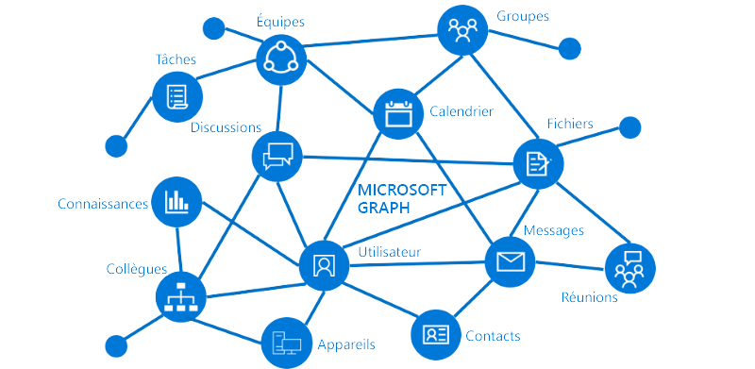

MS Graph ?
MS Graph is a REST API to connect to Azure to access data from Office 365, Intune…
Main idea is: All resources on the Cloud are interconnected
You can access to a huge amount of datas and access all resources:
Excel, Teams, OneDrive, OneNote, Outlook…
ATP, Azure AD, Intune…
Automate all action you can do on different portal (Azure, Intune…)
Graph is like the door to access to all your resources
Graph query link: https://graph.microsoft.com

Slide 11
What to do with MS Graph ?
11

Slide 12
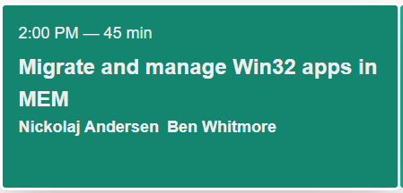
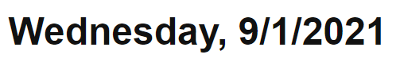
MS Graph and Intune
Check enrolled device and all information
Run remote actions on device: reboot, remote connection, wipe, locate device…
Deploy applications on devices
Migrate your application from MECM to Intune
Create reporting for your Intune devices
And many, many, many more…

Slide 13

MS Graph and Azure
Manage users: create, modify, remove, list information…
Manage groups: create, modify, remove, add members…
Access secrets (passwords) on Azure Key Vault
And many, many, many more…

Slide 14
Graph query structure
14

Slide 15

Graph API: Beta vs 1.0
There are 2 versions of the Graph API: Beta and 1.0
API 1.0: contains features that are generally available and ready for production use
Beta: to manage resources in Preview
Preview features are generally pushed first in Beta version
Beta API is subject to change,

Slide 16
Graph query: How is it composed ?
MS Graph link: https://graph.microsoft.com
API version: 1.0 or Beta
Resource: part to manage (user, device…) - Example devicemanagement/managedDevices
Structure: MS Graph link + API version + Resource to manage
https://graph.microsoft.com/API Version/Resource
https://graph.microsoft.com/1.0/devicemanagement/managedDevices
https://graph.microsoft.com/beta/devicemanagement/managedDevices
Manage a specific item (device user…) by adding item ID to the query
https://graph.microsoft.com/1.0/devicemanagement/managedDevices/mydeviceID
Use the appropriate method: GET/POST/PATCH/DELETE

Slide 17
Intune and resources
17

Slide 18
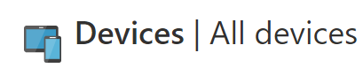
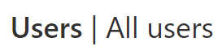

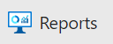
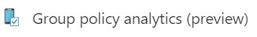

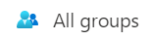
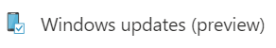
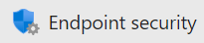
What is a resource ?
A resource is like a component located in Intune
A resource is something that can be managed trough the portal
Most known resources: devices, users, applications, proactive remediation script…

Slide 19
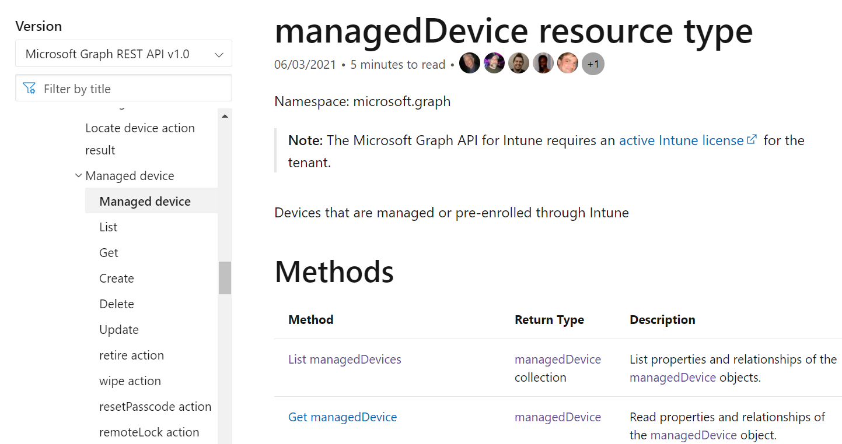
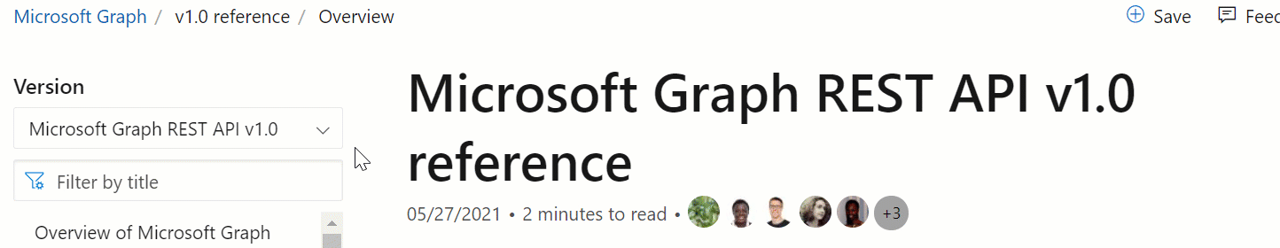
Getting info about a resource
To manage something, you should know the appropriate resource path
You can find a lot of information on the MS Graph API Reference
https://docs.microsoft.com/en-us/graph/api/overview?view=graph-rest-1.0
https://docs.microsoft.com/en-us/graph/api/overview?view=graph-rest-beta

Slide 20
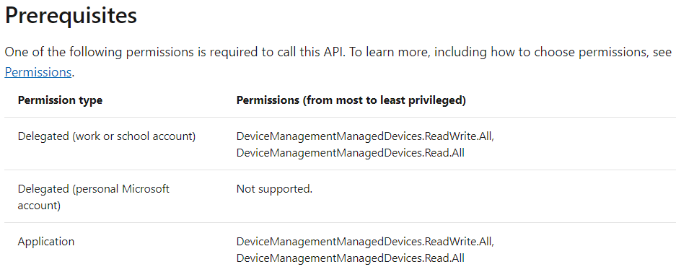
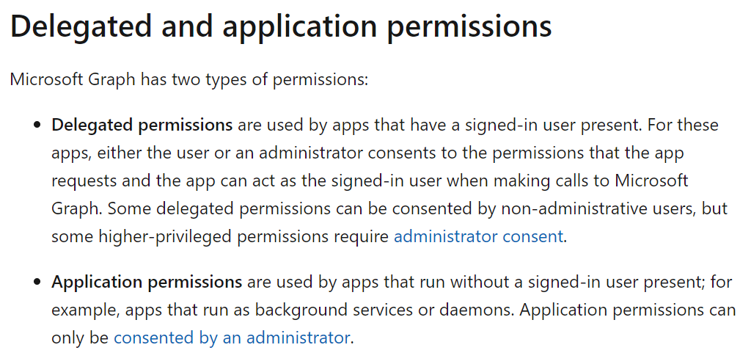
Resources and permissions
Each resource you want to manage require specific permissions
Go to the reference doc to know which permissions to apply
Example for managed devices

Slide 21
MS Graph and methods
21

Slide 22
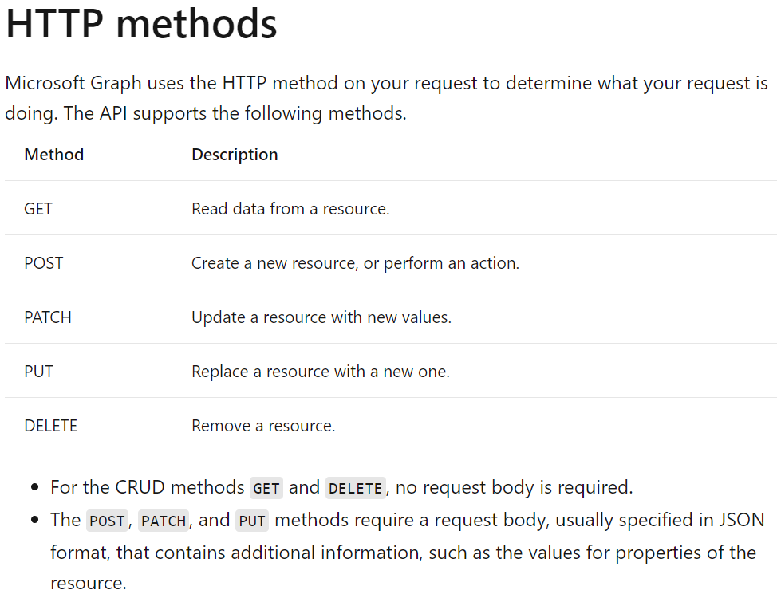
Choosing the appropriate method
Différents methods available
We will use below methods
GET / DELETE: no body
POST / PATCH: requires a body
For DELETE and PATCH, add ID of the resource in the Graph query link

Slide 23
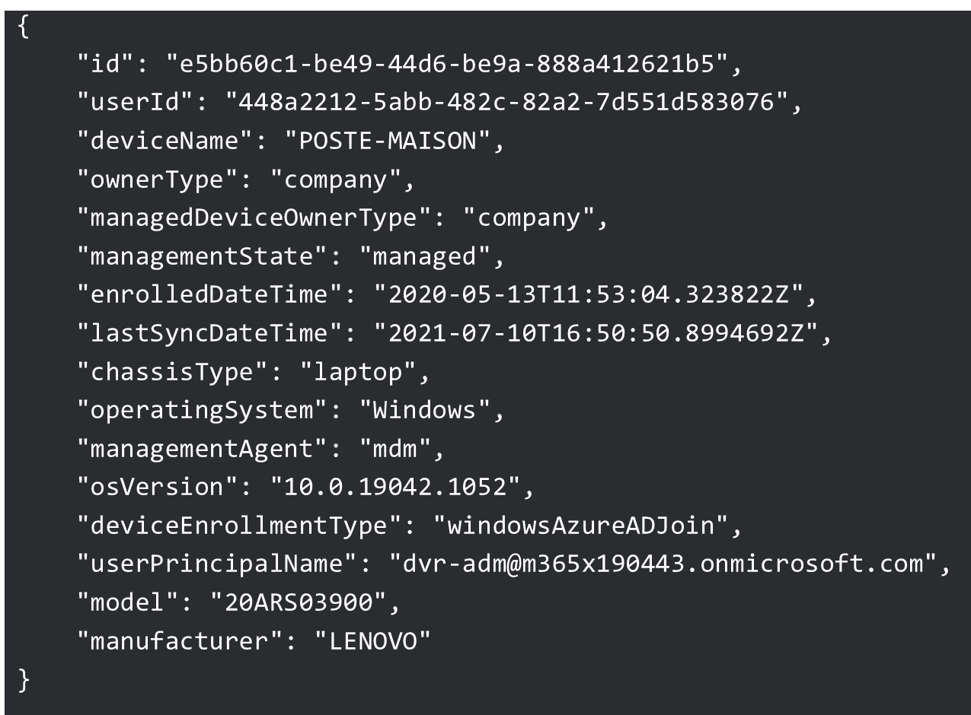
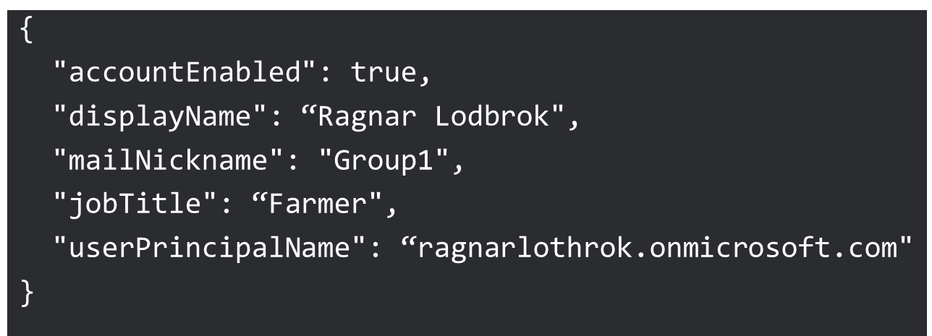
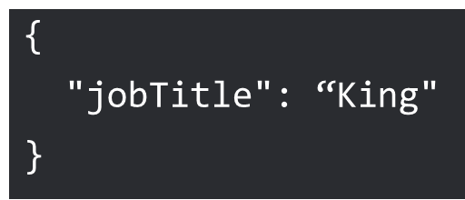
Post, Patch: What is a body ?
JSON format
Displays info about a specific item like a device
ID allows you to target the item
Required to create/modify an item like a device
Example 1: Create user
Resource to use: beta/users
Use method: POST
Example 2: Modify user
Resource to use: beta/users
Use method: PATCH
Add the ID of the specific item in query
Add fields to update in JSON

Slide 24
Graph Explorer…
24
A quick way to explore Graph

Slide 25
Graph Explorer: What is it ?
Overview
Available there: https://developer.microsoft.com/en-us/graph/graph-explorer
Website allowing you to explore Graph
Allowing you to understand notions of query, resource, method, body
How to use it ?
Sign in with your account
Choose the good method: GET, PATCH, POST, DELETE
Choose the good API version: v1.0 ou Beta
Type the resource
Examples
Enrolled devices: https://graph.microsoft.com/beta/deviceManagement/managedDevices
Proactive Remediation scripts: https://graph.microsoft.com/beta/deviceManagement/deviceHealthScripts

Slide 26

Using parameters in your query
Allows you to filter response of a query
Select: returns only specific properties
https://graph.microsoft.com/beta/deviceManagement/managedDevices?$select=deviceName,id
Orderby: order result on property depending descendent of ascendant
https://graph.microsoft.com/beta/deviceManagement/managedDevices?$orderby=deviceName desc
Other: Top, Count, expand, filter, format, search…
We will see that in a demo

Slide 27
Demo: Graph Explorer
What will we see ?
List devices
Filter information
List Proactive Remediation scripts

Slide 28
Easily find the good query
28
A quick way to find your query from the portal

Slide 29
Demo: Find your query
What will we see ?
Run action from the portal
Find the appropriate Graph query
Copy as PowerShell
Which actions ?
List devices
List proactive remediation script
Rename a device

Slide 30
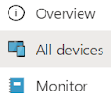
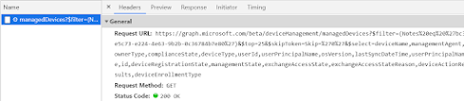
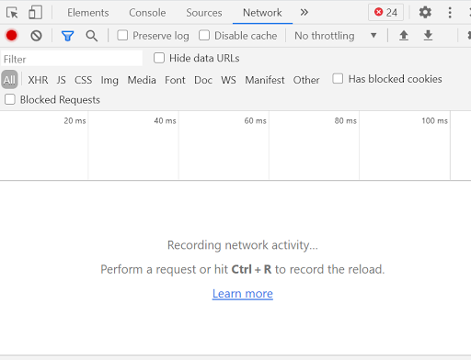
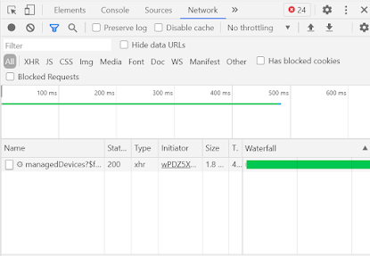

Finding the good query with a browser
Use Google Chrome, Edge Chromium…
Go to the Intune portal
Open the Developer mode with F12
Go to the Network tab
Run your action from the portal
Check the Network tab
Get the appropriate request URL and method
See my blog post there

Slide 31
PowerShell and Intune
31
Authenticating and managing your resources

Slide 32
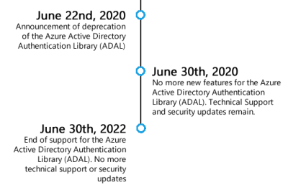

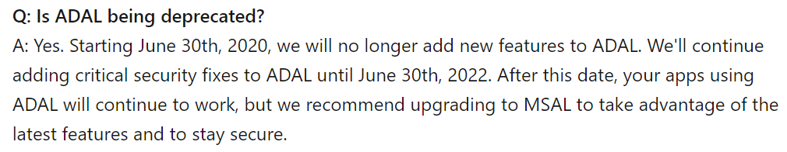
Modules available
Available on PowerShell Gallery: install-module Module name
Microsoft.Graph.Intune: ADAL (Active Directory Authentication Library)
Microsoft.Graph: MSAL (Microsoft Authentication Library)
MSAL.PS: MSAL (Microsoft Authentication Library)
ADAL vs MSAL: Different ways to authenticate

Slide 33

More about ADAL vs MSAL
Migrate applications to the Microsoft Authentication Library (MSAL)
Upgrade from ADAL to MSAL
Azure AD v2 and MSAL in 2020
MICROSOFT IDENTITY DEVELOPER: MSAL VS ADAL
Update your applications to use Microsoft Authentication Library and Microsoft Graph API
Azure AD: ADAL, MSAL?
THOSE WHO WISH ME ADAL
This is gold

Slide 34
How module works ?
Choose a module
Load the module
Authenticate to your tenant
Get a token
Play with Intune

Slide 35
Authentication and token
Different authentication methods:
By typing user credentials (interactive)
Providing credentials in a credential object
Providing a secret
Using a certificate
Authentication methods will help us to get a token
The token helps us to:
Prove the user identity
Prove that the caller has the proper permissions to perform an operation
We will see that later ☺
Azure application
What is a token ?

Slide 36
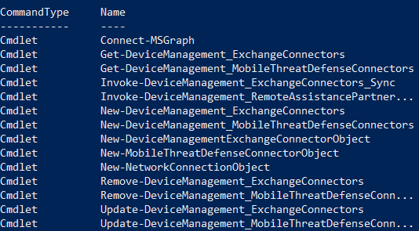
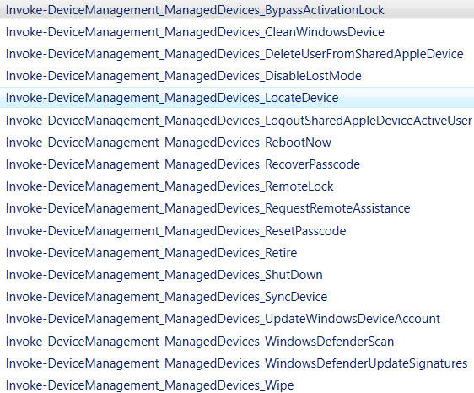

Microsoft.Graph.Intune
Contains many cmdlets to manage resources, execute actions… : 1569 cmdlets
Get-command -module Microsoft.Graph.intune | Out-GridView
You will find examples with MSAL.PS in the GitHub link

Slide 37
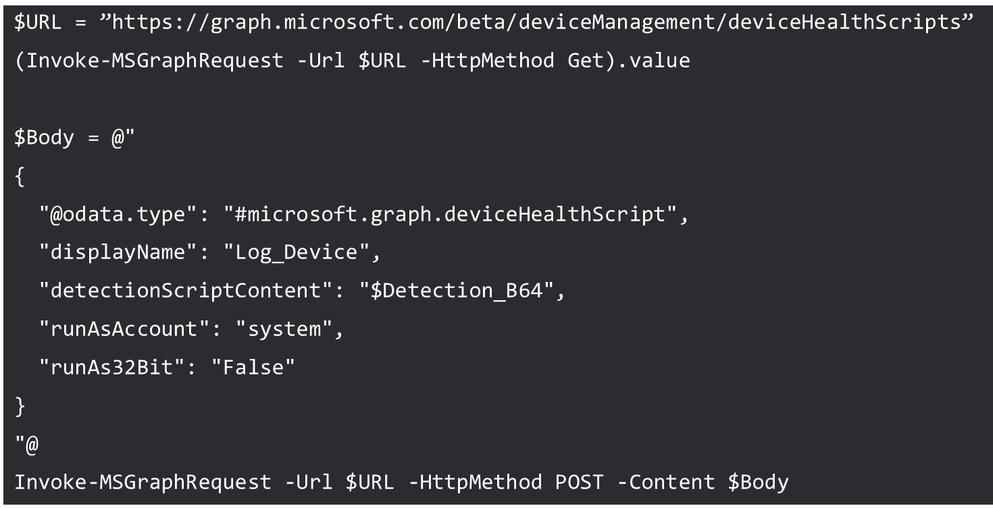
And if no cmdlets available ?
If there is no cmdlet available for what we want to do (Proactive Remediation scripts)
Cmdlet to use: Invoke-MSGraphRequest
Add URL resource in parameter -Url
Appropriate method using -HttpMethod
POST/PATCH: use -Content « JSON »

Slide 38
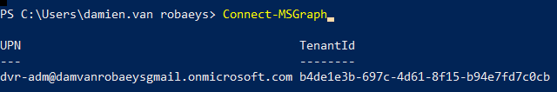
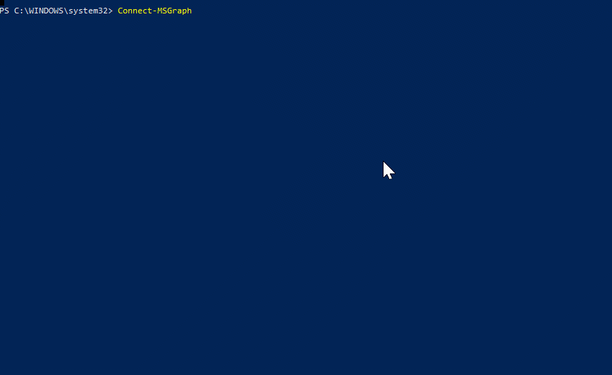
Basic Authentication
Cmdlet to use: Connect-MSGraph
Type your credentials in the prompt

Slide 39
Quick example: locate a device
Get the device ID
Format Resource URL: deviceManagement/managedDevices/DeviceID/locateDevice
Use method GET
Get location using deviceActionResults.deviceLocation
$Get_Device = Get-IntuneManagedDevice | where{$_.deviceName -like "$Device_Name"}
$Device_ID = $Get_Device.ID
$Managed_Devices = “https://graph.microsoft.com/v1.0/deviceManagement/managedDevices”
$URL_location = "$Managed_Devices/$Get_Device_ID"
$URL_locate_action = "$Managed_Devices/$Get_Device_ID/locateDevice«
(Invoke-MSGraphRequest -Url $URL_location -HttpMethod GET).deviceActionResults.deviceLocation

Slide 40
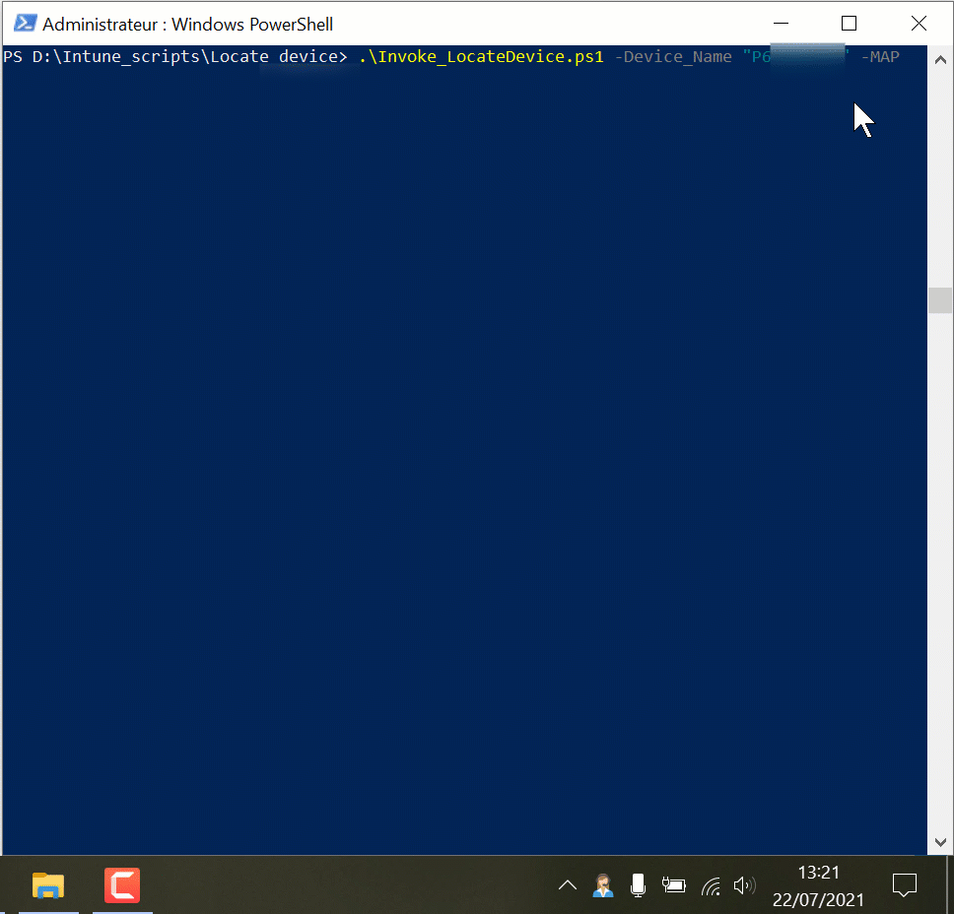

Quick example: locate a device
A quick script I created to locate device
Two versions: ADAL or MSAL
Displays last location
Display location in a MAP in your browser
Display exact address
Invoke_LocateDevice.ps1 -Device_Name "TEST" -MAP
https://github.com/damienvanrobaeys/Intune_Scripts/tree/main/Locate%20device

Slide 41
Authenticating without credentials
41
Using an Azure application

Slide 42

Azure application ?
Allows you to connect to your Intune tenant without providing credentials
What do you need to authenticate with the App and Posh ?
Application Client ID: A unique identifier, a sort of user name
Secret or Certificate: a sort of password replacement
Using a secret ?
Secret is easier to create and to use in a script
Using a secret is like typing your password in your script
Using a certificate ?
Certificate allows you to be sure that only required devices or users use the application
Not so easy than using a secret

Slide 43
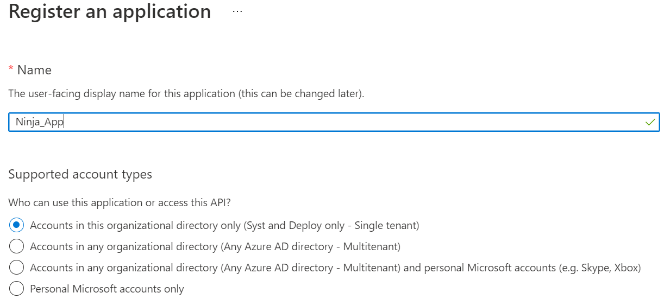
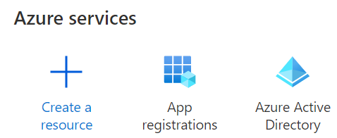
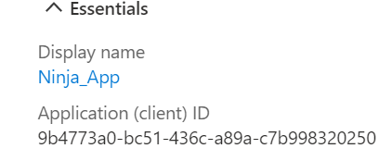
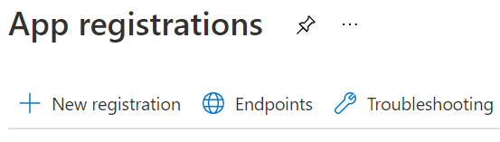
Creating Azure application
Go to Azure portal
Go to App registrations
Click on New registration
Type an app name
Keep in mind the ClientID and tenantID in Overview.
It will be used for authentication

Slide 44
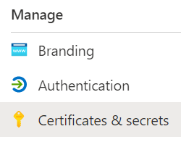
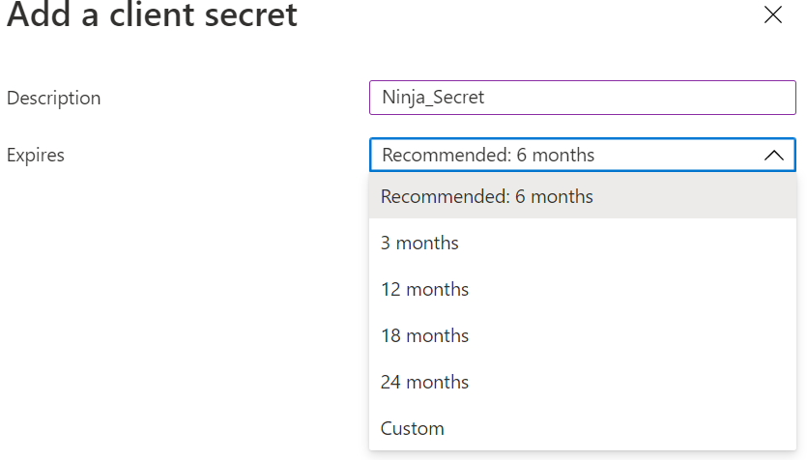
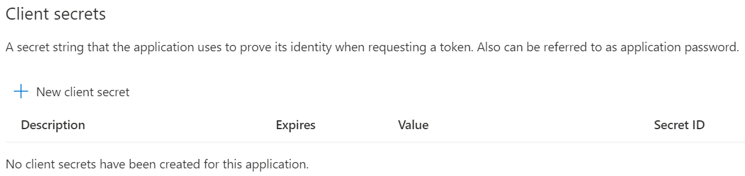
Creating a secret
The secret allows you to authenticate
It’s like the Azure application password
To authenticate we will need ClientID and Secret
Go to your application
Click on Certificates & secrets
Click on New client secret
Select description and expiration delay
Method for certificate available in the full PPT
Be careful, using a secret is like typing your password in the script

Slide 45
Authenticating using the secret
Store tenant ID and client secret in variables
Update Graph environment with Update-MSGraphEnvironment
Use Connect-MSGraph with -ClientSecret parameter
$tenant = “your tenant id”
$clientId = “Application client ID"
$clientSecret = “Your secret«
$authority = “https://login.windows.net/$tenant”
Update-MSGraphEnvironment -AppId $clientId -Quiet
Update-MSGraphEnvironment -AuthUrl $authority –Quiet
Connect-MSGraph -ClientSecret $ClientSecret -Quiet

Slide 46
Generating a certificate
Create certificate in User environment
Provider: Microsoft Enhanced RSA and AES Cryptographic Provider
$Cert_Name = "Intune_Certificate_SD"
$Cert_Location = "Cert:\currentuser\My"
$Cert_Export_Path = "C:\$Cert_Name.cer"
$Cert_Thb = "$Cert_Location\$MyCert_Thumbprint"
New-SelfSignedCertificate -DnsName $Cert_Name -CertStoreLocation $Cert_Location -Provider "Microsoft Enhanced RSA and AES Cryptographic Provider"
$MyCert_Thumbprint = (Get-ChildItem -Path $Cert_Location | Where-Object {$_.Subject -match $Cert_Name}).Thumbprint
Export-Certificate –Cert $Cert_Thb -FilePath $Cert_Export_Path

Slide 47
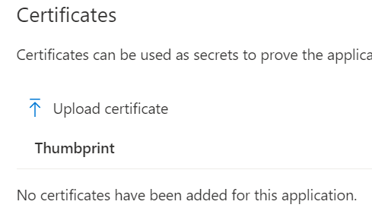
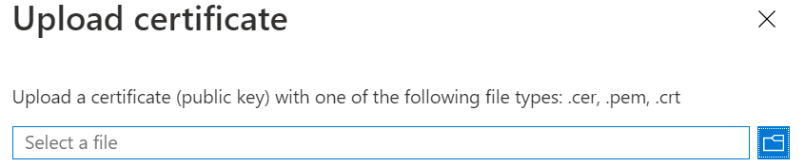
Uploading certificate to Intune
Go to your application
Click on Certificates & secrets
Click on Upload certificate
Browse your certificate and click on Add

Slide 48
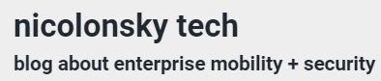
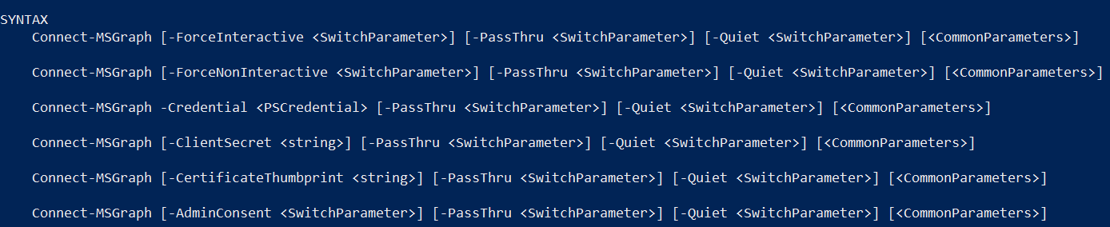
Microsoft.Graph.Intune and certificate
By default, the module does not allow to authenticate with a certificate
Nikola Suter uploaded the existing module to add this possiblity, check this link
Replace the existing module with the new one
A new -CertificateThumbprint parameter available
Works only with certificate located in user store

Slide 49
What about MSAL.PS ?
Get-MsalToken cmdlet to authenticate
Authenticate with secret
Authenticate with certificate
No cmdlet, use Invoke-RestMethod, add token in headers and use graph query URL
$clientId = "Application client ID"
$Secret = "" | ConvertTo-SecureString -AsPlainText -Force
$myToken = Get-MsalToken -ClientId $clientID -TenantId $tenantID -ClientSecret $Secret
$Thumbprint = "Certificate Thumbprint"
$Cert = Get-Item "Cert:\LocalMachine\My\$($thumbPrint)"
$myToken = Get-MsalToken -ClientId $clientID -TenantId $tenantID -ClientCertificate $Cert
$URL = "https://graph.microsoft.com/beta/deviceManagement/managedDevices"
(Invoke-RestMethod -Headers @{Authorization="Bearer $($myToken.AccessToken)" } -Uri $URL -Method Get).value

Slide 50
Demo: authentication
What will we see ?
Authentication methods
Creation of an Azure application
Which actions ?
Basic authentication
Authenticate through Azure app
Add permissions
List devices

Slide 51
Creating custom reports
51
using proactive remediation scripts

Slide 52
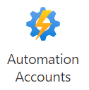
Things to know before starting ?
Proactive Remediation
Part of Intune or Microsoft Endpoint Manager
Located in Endpoint Analytics > Reports
Allows you to detect devices with issues and remediate them
Composed in 2 parts (scripts): Detection and Remediation
Allows you to provide output in your script
Can be a quick way of reporting: get info you want not only info provided in Intune
Azure Automation
Part of Azure
Allows you to run a script (called a Runbook) directly from Azure
You can schedule the script
You can run it on on-prem environment
You can import modules and use Graph

Slide 53
What’s the idea ?
Get device datas with Proactive Remediation script
Create Azure automation runbook
Get datas from remediation script
Export datas to a CSV and upload to blob
Display it in Power BI

Slide 54
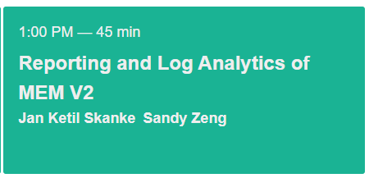
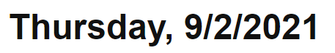
Another session about reporting
Another session about reporting
Using log analytics

Slide 55
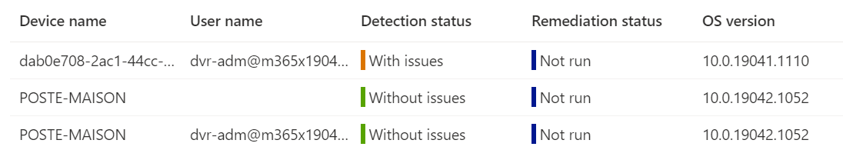
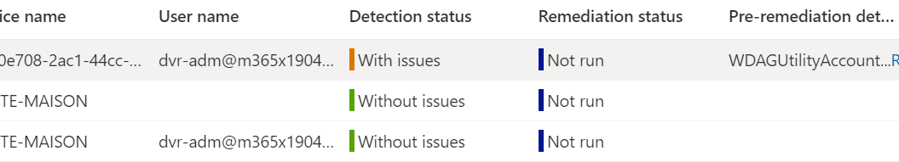
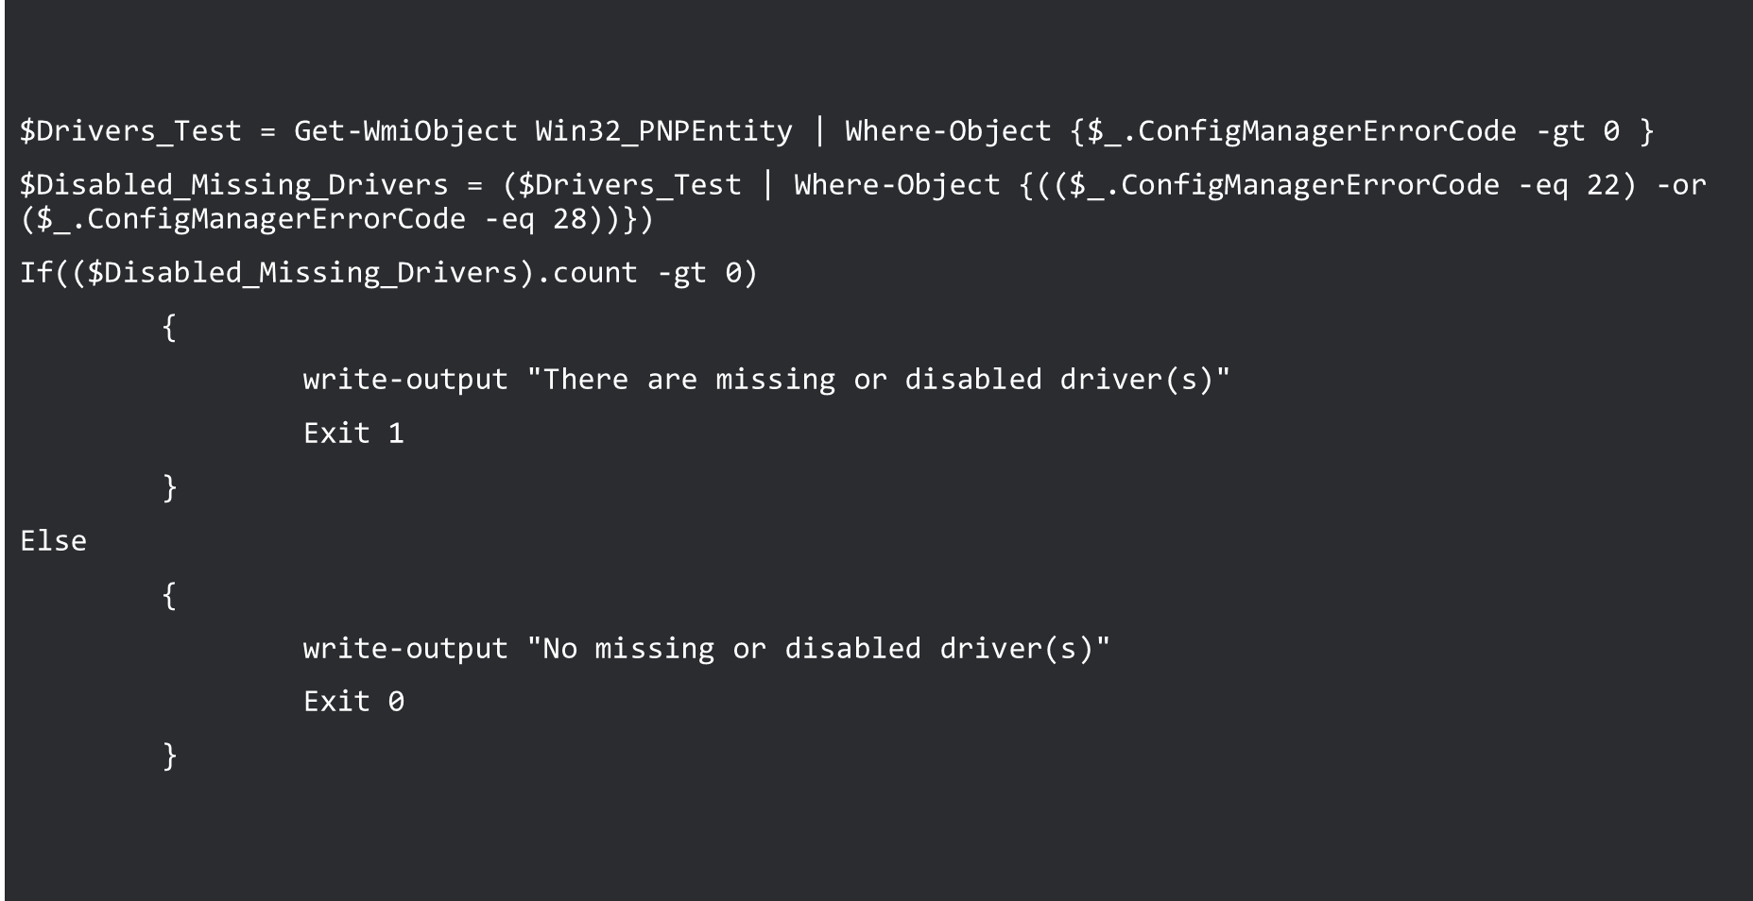
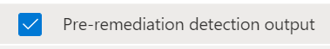
Proactive Remediation output
This allows you to get all info you want on a device: drivers issue, list local admin, bios update exécution…
Info from write-output are available in part Pre-remediation output in Proactive Remediation report

Slide 56
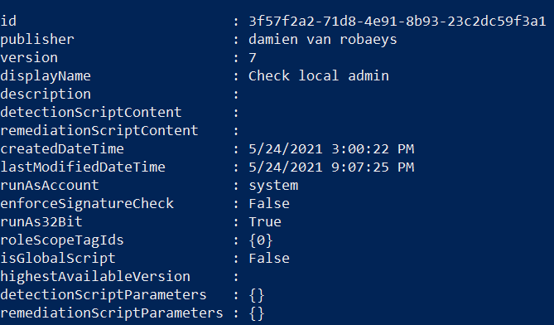
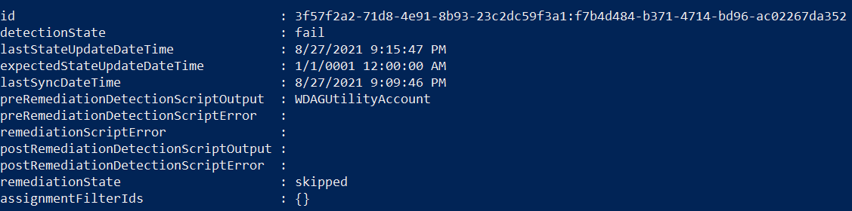
Proactive Remediation output
deviceManagement/deviceHealthScripts ➔ List summary of the script
deviceManagement/deviceHealthScripts/scriptID/deviceRunStates ➔ Get details of the script

Slide 57

Proactive Remediation output
Case 2: Export multiple values from the device (check if local admin and export account names)
We will add all things we need in an array and each data will be separated with a « ; »
In our example each accounts that are member of the local admin group

Slide 58


Power BI report sample

Slide 59
Demo: proactive remediation and Graph
What will we see ?
Use Graph and Proactive Remediation
Get output result of a script

Slide 60

Proactive Remediation output
Case 3: Export multiple values from the device (check drivers issues)
We will get device name, driver error code, driver name, driver ID

Slide 61



Exporting content from Graph
Content in the script output
Resource to manage Proactive Remediation script: deviceManagement/deviceHealthScripts
Get info about the proactive remediation script
Get information about the script execution
Format remediation details
Get info about a script, ID, name…

Slide 62

Exporting content multiple values
preRemediationDetectionScriptOutput = "$Error_type;$DRV_Name;$Driver_DeviceID-"
Split preRemediationDetectionScriptOutput
in different variables
Gather values in an array

Slide 63







Azure Automation implementation
Prerequisites
An Azure account
A Storage account with resource group
Go to Automation Accounts
Click on Create
Fill your account
Add required modules (module Intune, Sharepoint…)
Create a Runbook (script to export datas)
Copy script to export content from proactive remediation
Test your Runbook
Schedule the runbook

Slide 66



